Slide 1
Financing: Central Baltic 1.5m€
Project period: 1.10.2016 - 31.8.2019
8 project partners
Åbo Akademi (Lead partner, Nina Söderlund)
Pargas stad
Novia UAS
Föreningen Franciscus på Kökar
Sottunga kommun
Söderhamn kommun
Östhammar kommun
Pilgrimstid Sverige

Slide 3
James Simpson
Project manager –
City of Pargas
james.simpson@pargas.fi
Tel: +358 40 488 5977
@olavinreitti
www.facebook.com/
www.instagram.com/
www.twitter.com/ www.soundcloud.com/

Slide 4
Channels
Social Media
Facebook page
Facebook groups
internal, work place, interest groups
Twitter
Instagram
Soundcloud
Youtube
Face-to-face
Seminars
Exhibitions
Associations
Other
Newsletters
Webpages

Slide 5
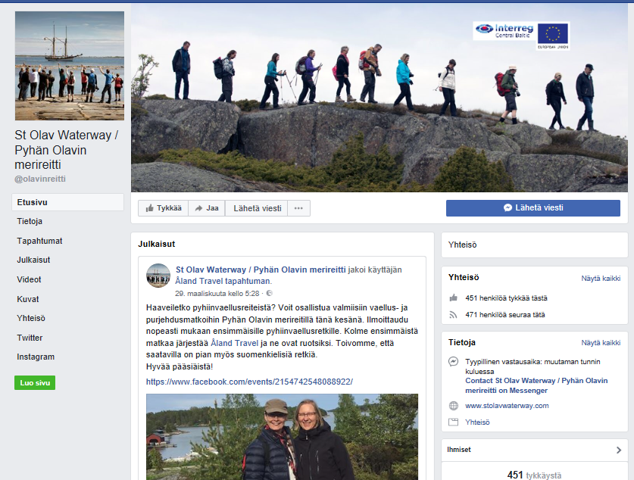
SOME thoughts
Who are your audience
Stake holders and target groups
How to reach them
What to communicate to them
What action do you wish them to take
How often
Plan

Slide 6
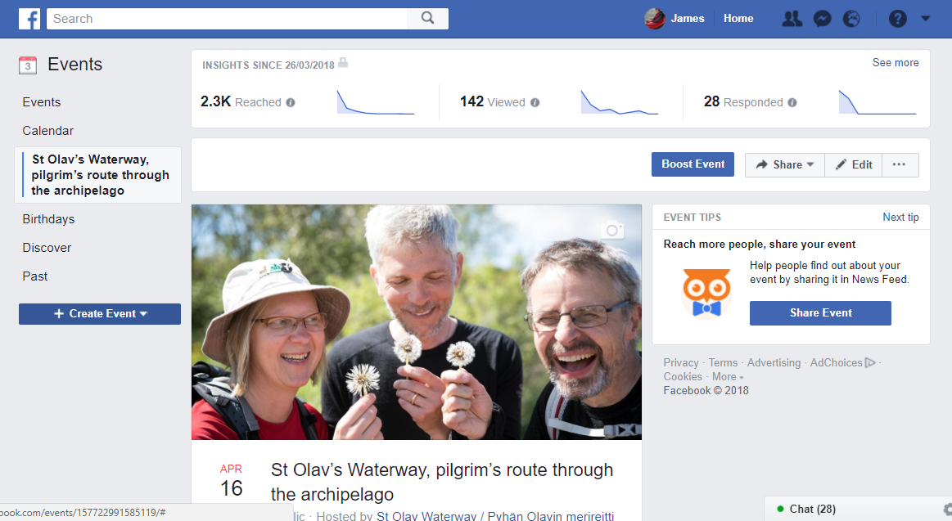

Slide 7
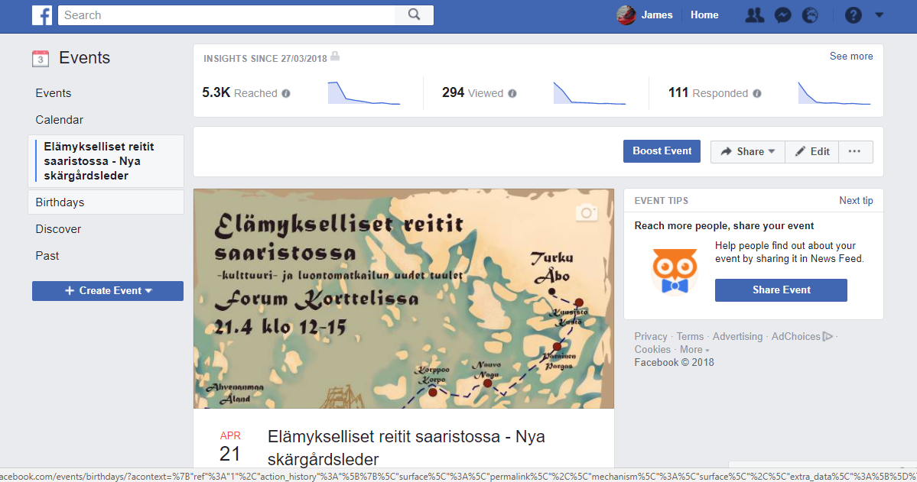

Slide 8
Twitter

Slide 9
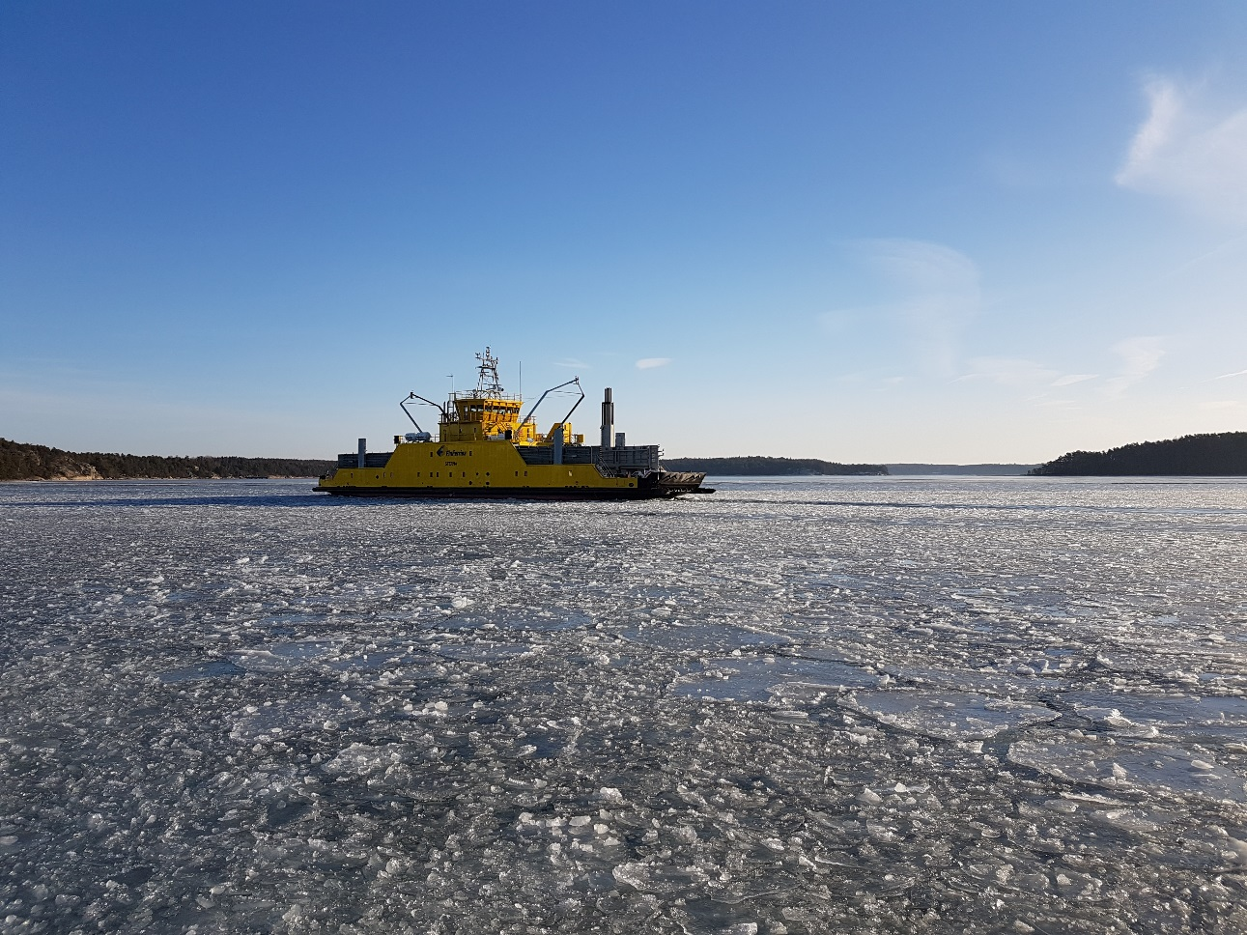
Kiitos, Tack, Thank you!
StOlav Waterway
james.simpson@parainen.fi
Tel: +358 (0)40 488 5977
www.facebook.com/olavinreitti

