Slide 1


Welcome to the Central Baltic communication seminar!
It will be recorded.
We will start at 10.00 (EST, FI, LV) /
9.00 (SE)
Nice to see you!
Please keep your mic muted while presentations
You can ask questions in Slido
You can write comments in the chat
Enjoy the seminar and get inspired!
You're welcome to join the knowledge exchange hour after the seminar

Slide 2
What’s on our plate today?
10.05 Why storytelling?
10.15 Inspiration from project LightsOn! – Nina Luostarinen, HUMAK
10.45 Ingredients for a good story
How to improve your photos
Creating short videos – it is easier than you think!
11.15 Break (5 min)
11.20 More ingredients for a good story
Stories inside the projects
My storytelling story
11.40 Wrapping up
11.55 Closing
12.00 Lunch break (30 min)
12.30 Optional networking hour
Notes:
What’s on our plate today?
During the first half we will get to know what is storytelling all about, hear an inspirational speech from Nina Luostarinen and learn about pictures and short videos.
After the break, we will learn about how to actually find the story and hear a personal storytelling story.
After lunch break we will have optinal networking hour where you can share your experiences and learn from others.

Slide 3
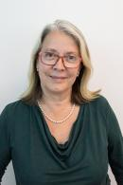

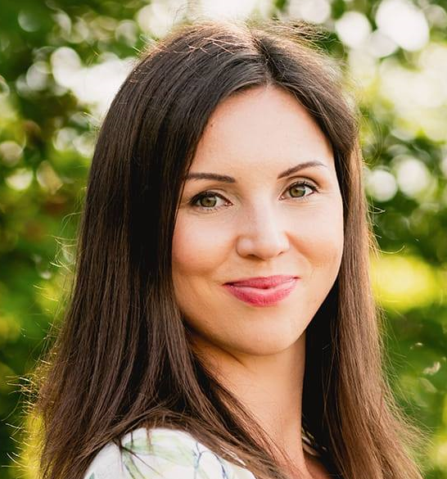
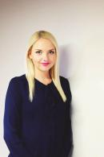

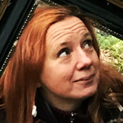
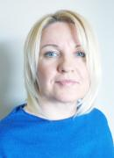
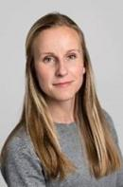
Today's storytellers
Annika Holmström
Contact Point
Sweden South
Ester Laurell
Contact Point
Åland
Kersti Valde-Komp
Communication
Specialist
Annika Mändla
Contact Point
Estonia
Julia Jokelin
Contact Point
Finland
Nina Luostarinen
Lecturer
HUMAK University of Applied Sciences
Daiga Jumburga
Contact Point
Latvia
Rebecka Frej
Contact Point
Sweden North

Slide 4
Slido – our tool for interaction today
Please, join at slido.com
#928741
Audience Questions & Answers

Slide 5

Why storytelling?
Julia Jokelin
National Contact Point Finland

Slide 6

What is storytelling?
Process of using fact and narrative to communicate
Telling something by using stories
Part of service design
  Customer experience
  Branding
The story can be written text, verbal, video, picture or mixed – the shorter the better!

Slide 7
Why storytelling?
Amazing marketing tool
  Emotions instead of information brochures
  Shared identity between audience and the brand
  Regular content marketing made entertaining
  Helps to create more personal connection to your audience
Possible outcomes
  Makes your company or project more personal and relatable = happier and more engaged audience
  More understanding, more visibility

Slide 8
How to create a story?
Finding the story
  Your project is filled with different size of stories!
  Creating a fictive story based on real experiences
What makes a good story?
  Has a beginning, a conflict and a resolution
  Is authentic – if possible, use real names and details
  Stays true to your brand
  Wakes up the sensories
  Stays short

Slide 9

Disneyland Paris – The Little Duck

Slide 10
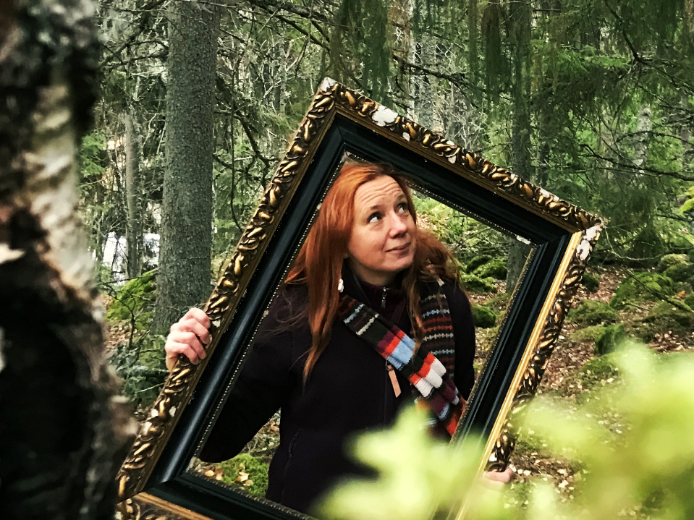
NINA LUOSTARINEN

Slide 11
Angles
- take 10 extra seconds
Rebecka Frej, National Contact Point Sweden North

Slide 12
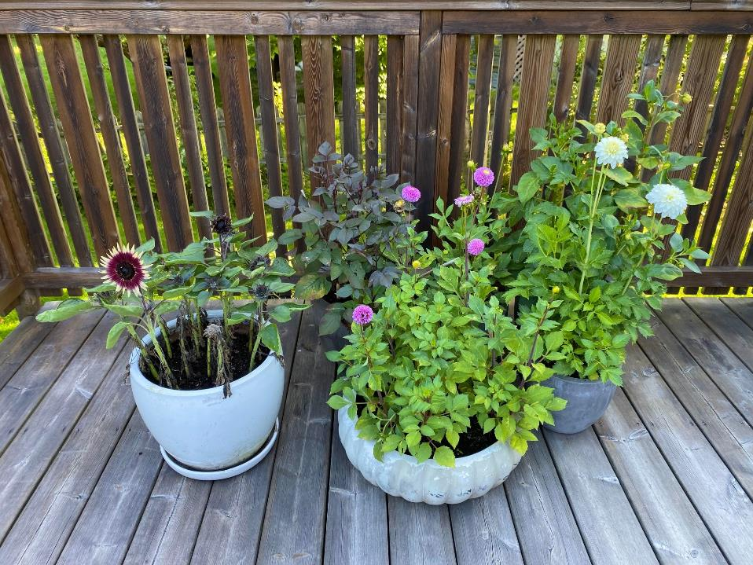

Slide 13
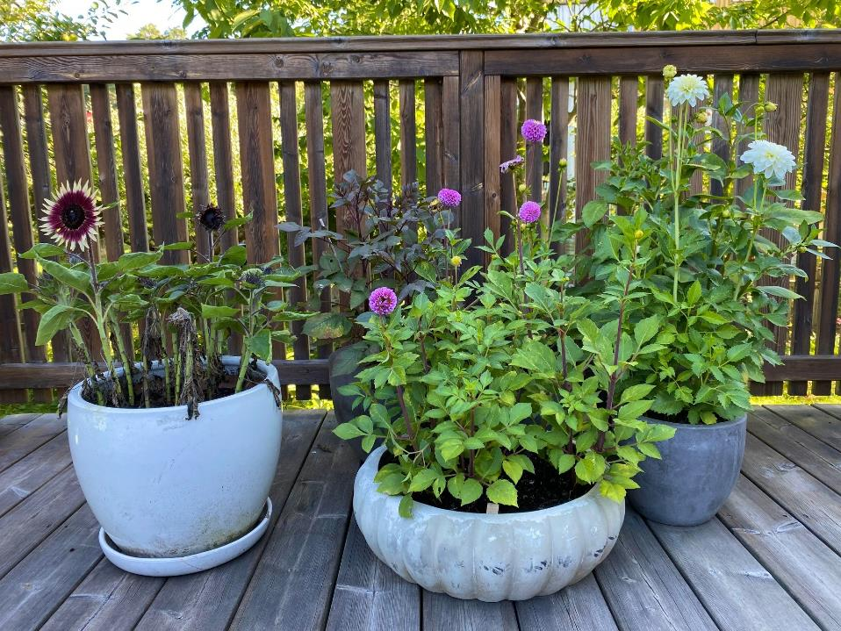

Slide 14


Slide 15
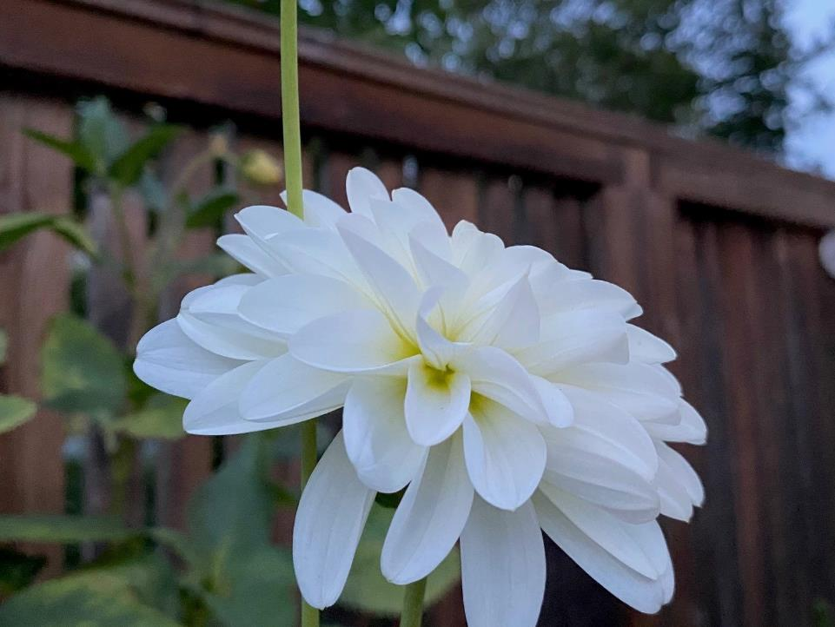

Slide 16
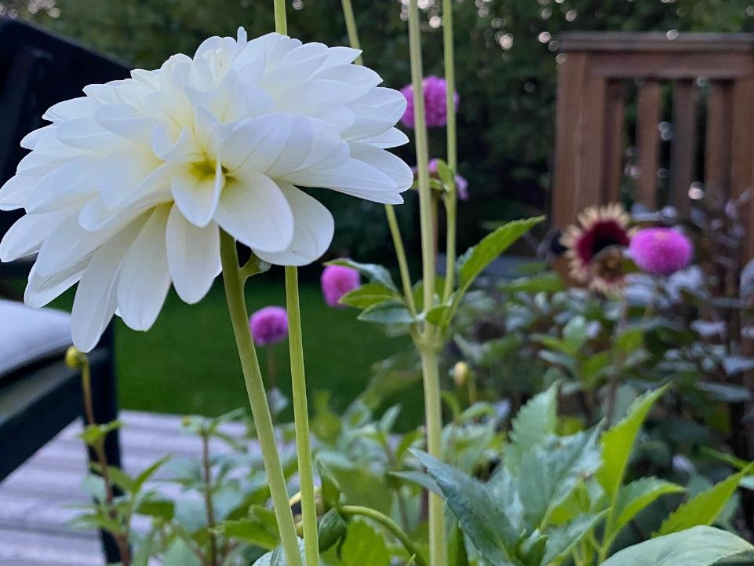

Slide 17
Shoot through something – adds a dynamic to the photo

Slide 18
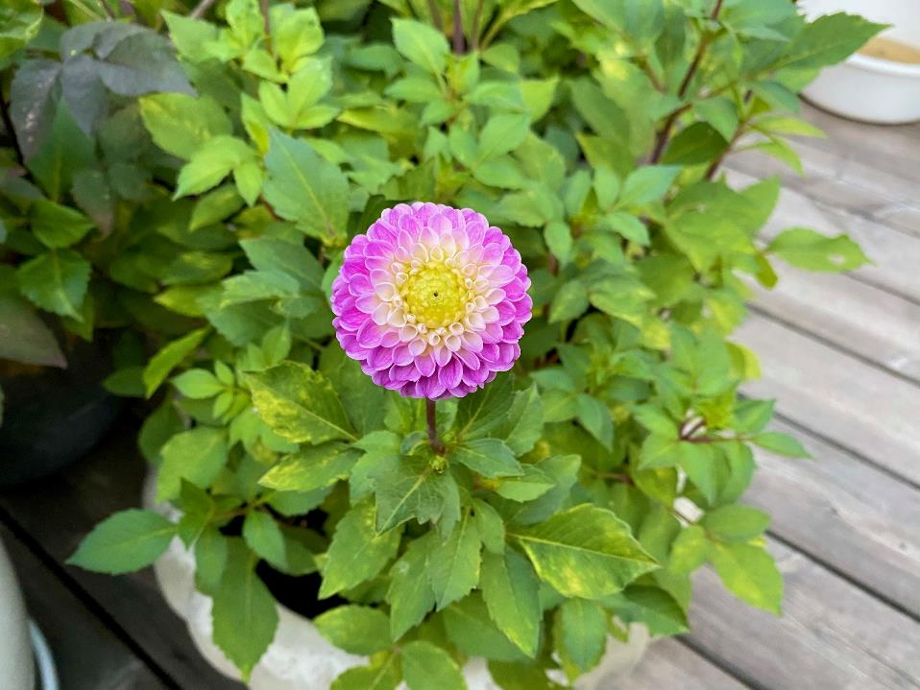

Slide 19
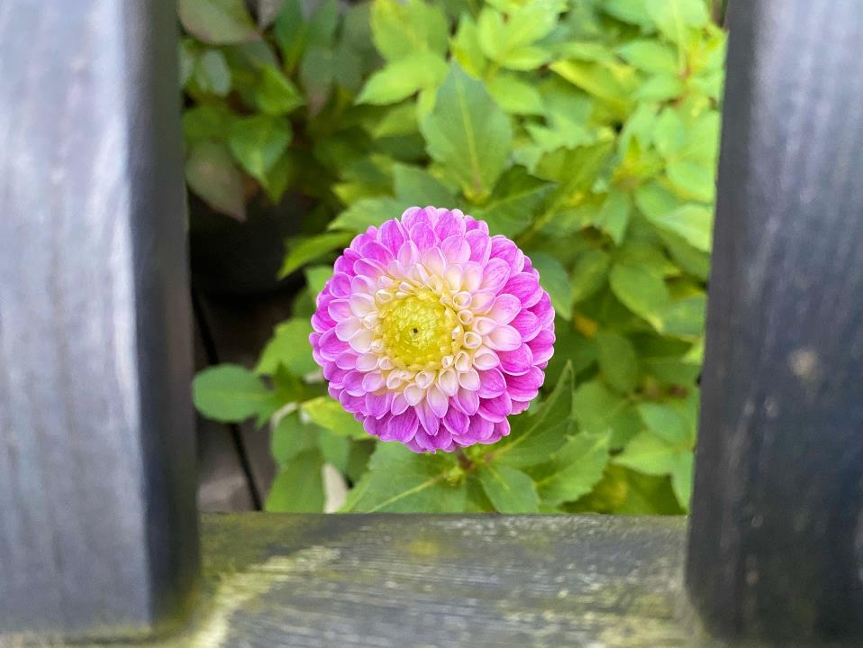

Slide 20
Think opposite
– do not snap the ordinary photo

Slide 21
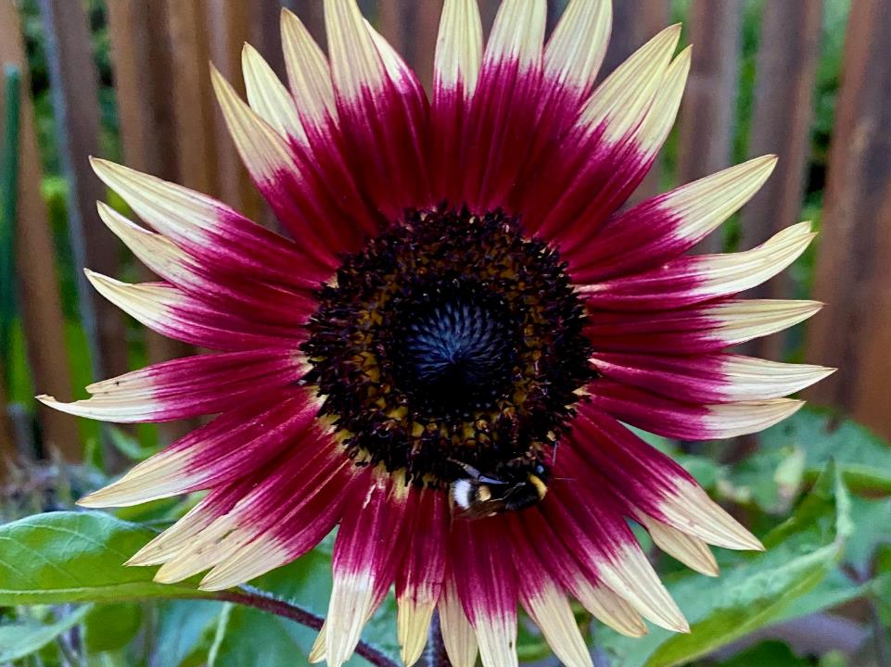

Slide 22
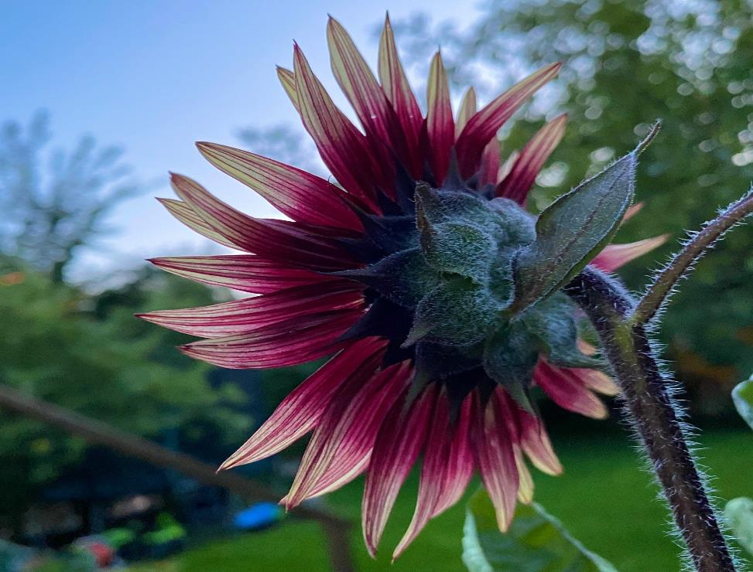

Slide 23
Lighting
– makes a huge difference

Slide 24
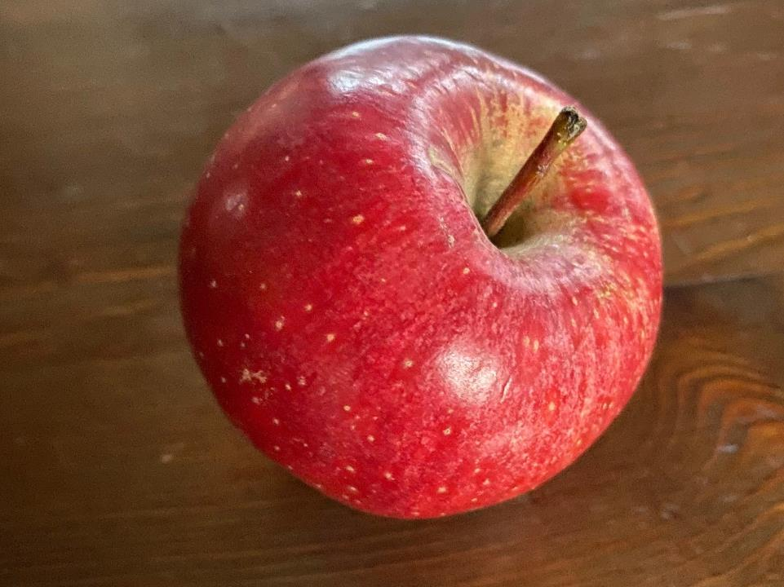

Slide 25
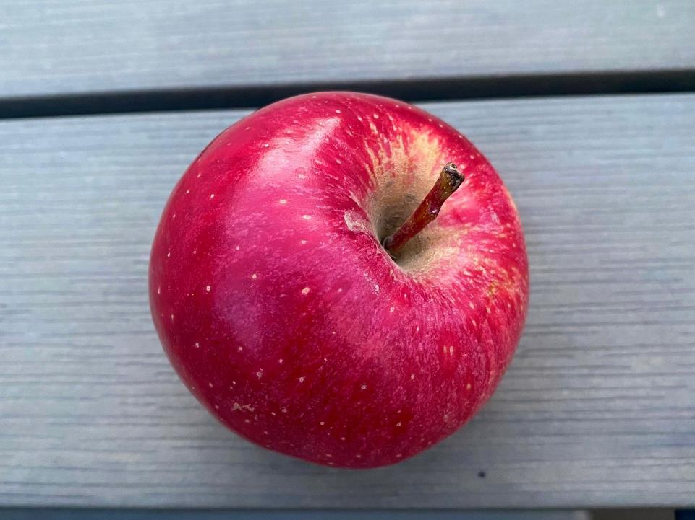

Slide 26
Framing
– placing objects helps tell the story and creating an atmosphere

Slide 27


Slide 28
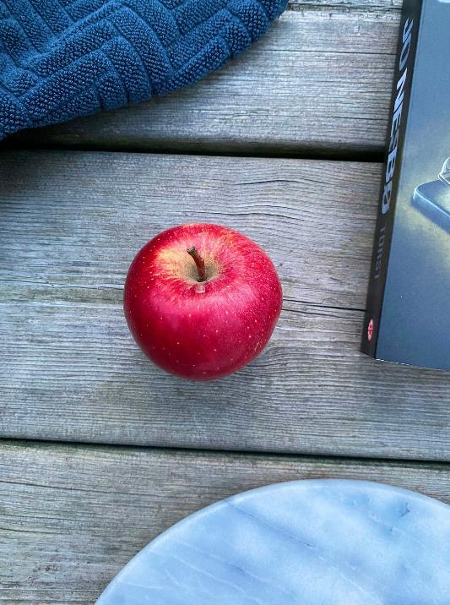
Notes:
After Rebecka: Daiga and creating short videos with Canva.

Slide 29


Communication seminar
25 Aug 2021
Daiga Jumburga
NATIONAL CONTACT POINT OF LATVIA
SHORT & SIMPLE
#INTRODUCTION

Slide 30
ENTER Canva.COM
&
CREATE FREE ACCOUNT

Slide 31

Templates

Slide 32
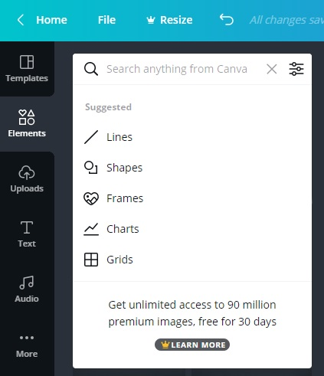
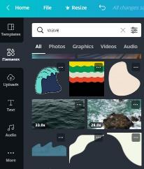


elements

Slide 33
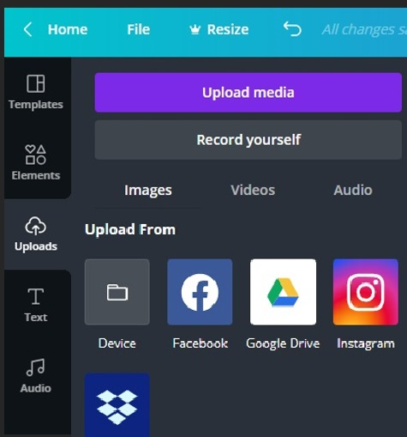
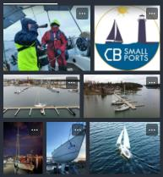

uploads

Slide 34
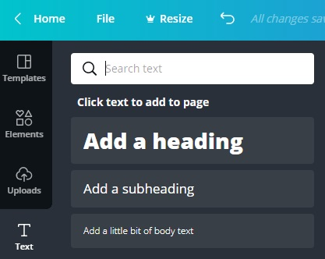
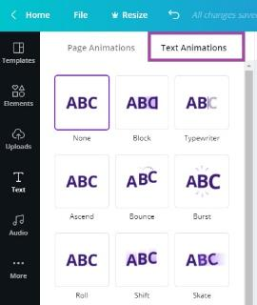
text

Slide 35
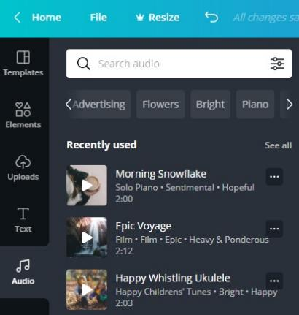
audio

Slide 36

more?
1) Upload pictures;
2) Add Elements, Text and Audio;
3) Cut, Crop, Flip, Animate
Download MP4 video & share!

Slide 37

🎣 #CBcope
introduces with and reminds about
Central Baltic Programme projects
for your inspiration, ideas and information,
- published on Facebook @Interreg.lv.
Pictures from project «CBSmallPorts» partners - Thank you!

Slide 38

Daiga Jumburga
NATIONAL CONTACT POINT OF LATVIA
THANK YOU!
daiga.jumburga@varam.gov.lv
Centralbaltic.eu
Interreg.lv
Notes:
After Daiga: Annika H. and creating a video with your smartphone.

Slide 39
Communication seminar 25 Aug 2021
Storytelling – ”Cooking” a video
nCP Sweden Annika Holmström

Slide 40
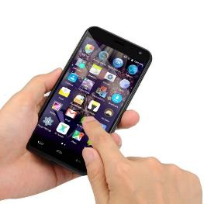
About storytelling via the smartphone
Produce a short video with the help of the smartphone about something that happens in your project - a combination of photos and super short video clips (just a few seconds)
Remember: The final video must be less than 60 seconds
– otherwise it will be too “heavy” to use in social media

Slide 41

Preparations
Take ordinary photos often.
Take super short video clips during all kinds of activities.
Download an app to your smartphone for producing videos.
Choose photos and video clips.
Combine to a short video with the help of the App.
Decide which text/headlines to use – the name of the project, the activity, the date, etc
Mandatory logos
Add back ground music?
Go!

Slide 42
My CB video
Marketing the CB-project Lakesperience by showing a walk along the Östgöta path in the county of Östergötland in Sweden on European Cooperation Day 2020.
Because of the corona situation – a walk just together with my husband and our dogs.
Still possible market the project and the nice walk in Östergötland by the help of the video.
42 second video

Slide 43
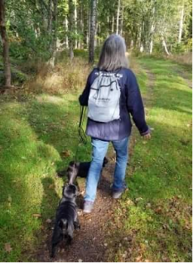
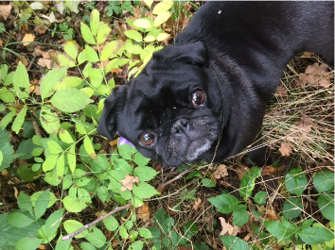
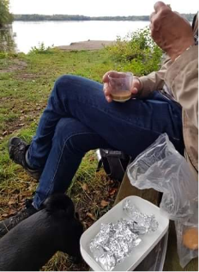
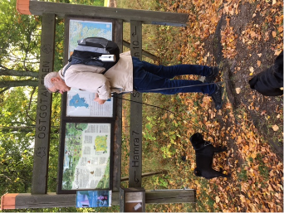
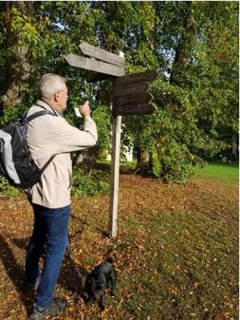

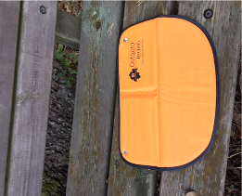
7 photos

Slide 44
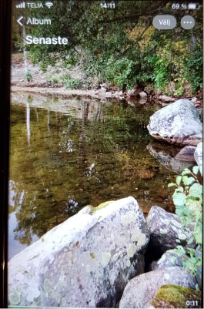
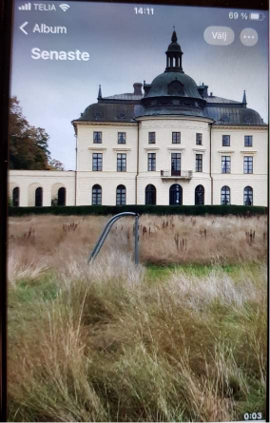
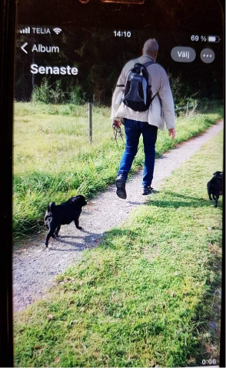
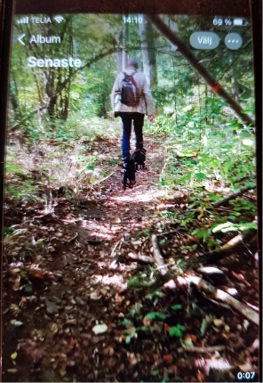
4 video clips

Slide 45

The tool – an app to produce the video
I used InShOt - https://inshot.com/
In the app you can e.g.:
- Trim video, Remove the middle part, Split video, Merge clips, Adjust speed.

Slide 46

Finalise the video
Decided the order of the photos and video clips
Uploaded those in the app
Shortened the video clips to suit the format
Added headlines by the help of the app
Added music
Done
Now your project can inspire others!

Slide 47
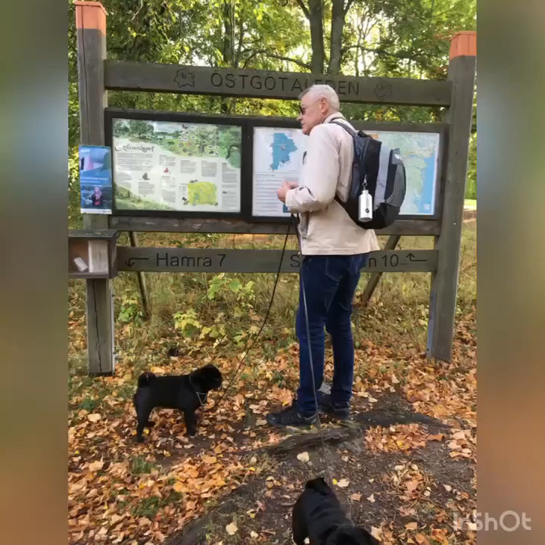
My final video
Link: https://www.facebook.com/annika.holmstromatwork/videos/797719981059126

Slide 48
Thank you! annika.holmstrom@regionostergotland.se
Notes:
And now we will have a short break. Please, strech, take a cup of coffee and come back at 11.20.

Slide 49
Short break

Slide 50
Annika Mändla
Contact Point Estonia
Notes:
Starting at 11.20 (EET)

Slide 51
Stories..
Everyday work – things might feel not story worthy
Boring press releases – facts and figures?
Finding a story..
Think what people want to hear. Not always what you want to tell
Use people and their personal stories (spokesperson?)

Slide 52
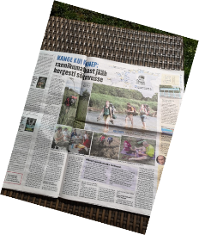
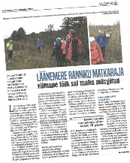
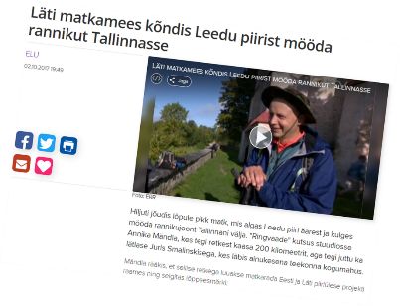
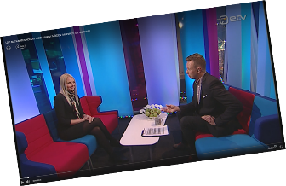
Example from Coastal Hiking project
Developing a hiking trail – that is not a story itself
A man walked 1100km – that is a story

Slide 53
Why?
Help to reach greater purpose: attract people to hiking trail (actually use the product we are creating), get a knowledge about it and about the area
Get recognision for our work: possibly better funding opportunities in the future, reliable partners and so on
Notes:
After Annika M.: Ester

Slide 54
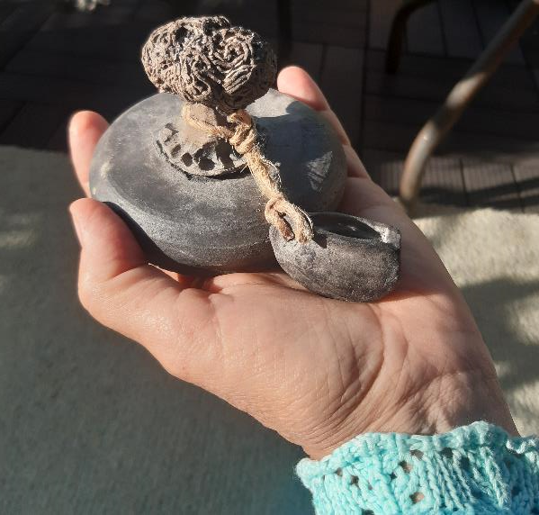
My storytelling story
Ester Laurell
National Contact Point Åland
Notes:
Starting at 11.30 (EET)

Slide 55
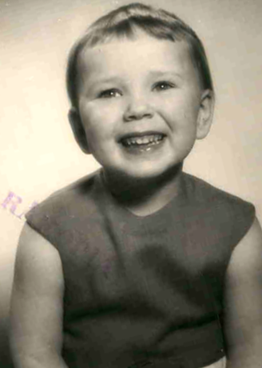
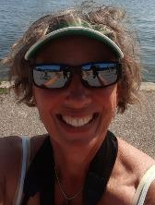
My values?

Slide 56
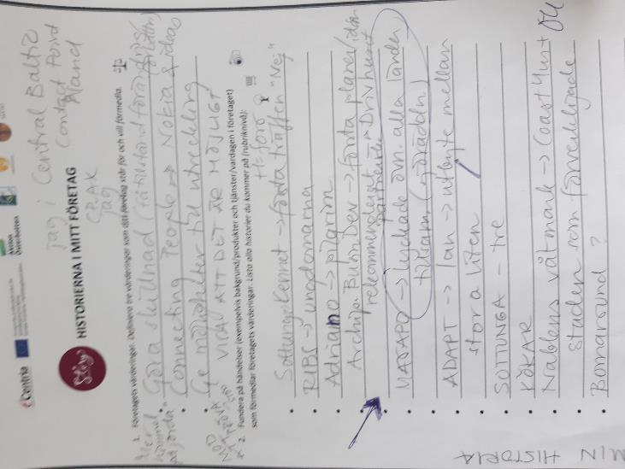
Concrete situations as headlines

Slide 57
Choose one - refine
Who?
Where?
What?

Slide 58
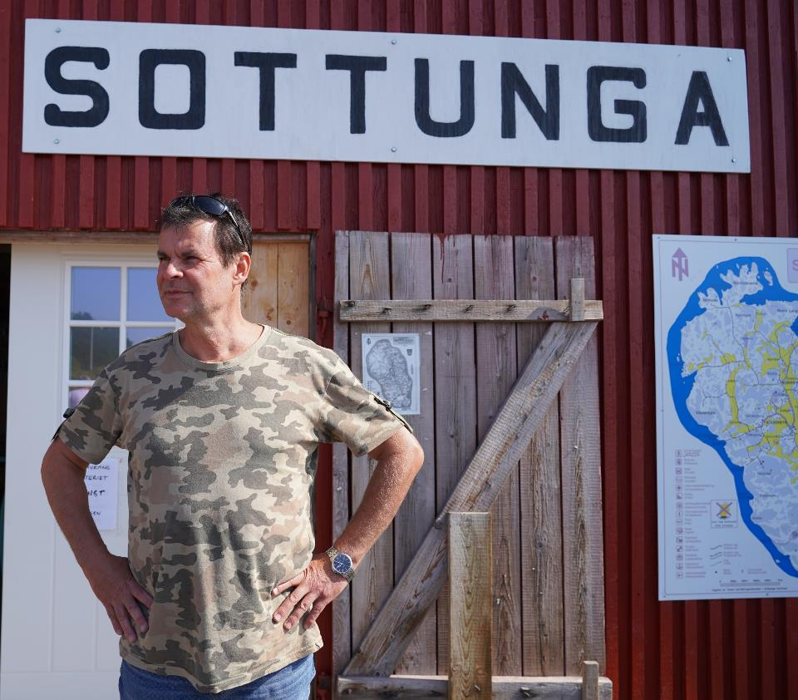

Slide 59
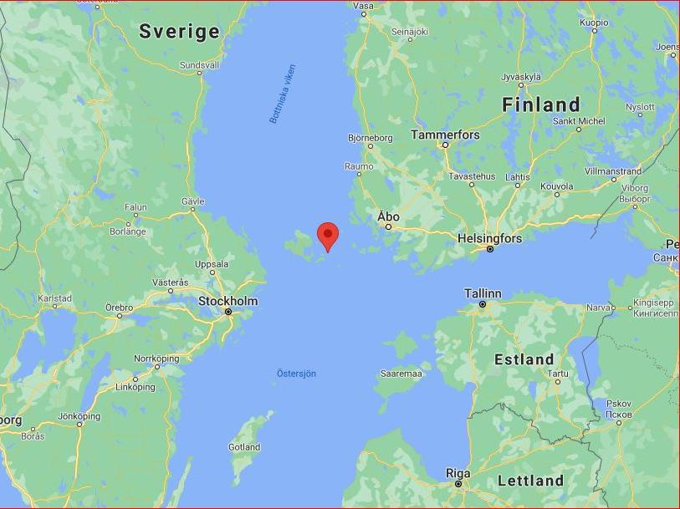

Slide 60
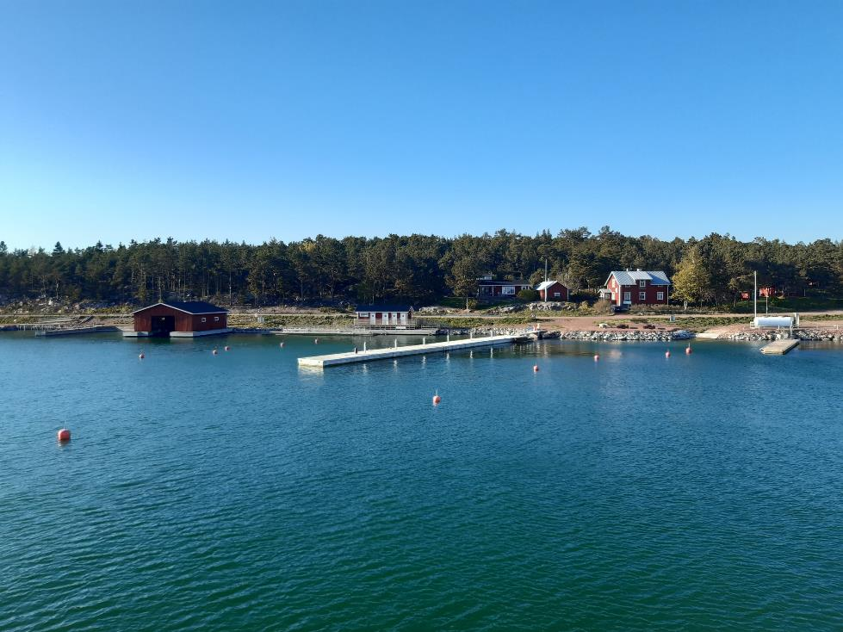

”Once upon a time...”

Slide 61

One year later:
20 stories,
40 individuals =
my personal ”CB heritage”
http://centralbaltic.eu/sites/default/files/documents/CB%20STORIES%20Archipelago%20and%20Islands_Swedish.pdf

Slide 62

!
What is the shape of YOUR story
?
Humans
We
slido.com #928741
Audience Q&A

Slide 63
Communication seminar 25 Aug 2021
Wrap-up session
Kersti Valde-Komp, Communication specialist

Slide 64
Power of a simple story
Storytelling gives your audience a sense of engagement and a better understanding of your project results and values.
Notes:
Ilga

Slide 65

What was on the menu?
Using short videos in project marketing
Spotting the pictures
Creating short videos
Stories inside the projects
Storytelling story

Slide 66

Rules of cooking
Review the following documents:
The Programme Manual
The overview table and
The FAQ (provides case-specific examples).
Needed references:
The flag of the EU together with the textual reference ‘European Union’
Textual reference ‘European Regional Development Fund’
The logo of the Central Baltic Programme 2014-2020

Slide 67


What’s cooking?
Join our channels in social media
Facebook page:
Central Baltic Programme
Facebook group:
Central Baltic Networking Community (385 members)
Follow us in
Twitter
Instagram
Newsletter(s)

Slide 68
Thank you! kersti.valde-komp@centralbaltic.eu
www.centralbaltic.eu
CentralBaltic
Central Baltic Programme

Slide 69
End of part 1
Recording of the seminar and all the material will be available afterwords on our website
Feedback questionnaire
Save the dates
  23 September 2021
  Central Baltic Annual Event & European Cooperation day
  15 November 2021
  Launching of the new Central Baltic programme 2021-2027
Notes:
Even though this is the end of the part 1, the story continues after lunch break…
Recording of the seminar and all the material will be available on our website after this event.
We will also send you a feedback questionnaire. Could you please Daiga tell us more about it?
I would also like to remind you about the important dates for this fall.
On september we will have the Central Baltic Annual Event. The registration is now open and Daiga will share the registration link in the chat.
On November we will organize a launch event for the new programming period. Stay tuned!

Slide 70
Peer-to-peer knowledge exchange session – part 2
We warmly welcome you to join the peer-to-peer knowledge exchange session starting at 12.30 (EST, FI, LV) / 11.30 (SE) after lunch break!
  Questions and answers
  Knowledge exchange
  Discussion
  Support
Notes:
We would like to invite you to join us in peer-to-peer knowledge exchange session right after lunch break. The session will take place in this same Teams meeting, so you don’t have to close this.
During the peer-to-peer session, we will answer to your questions and participants can share their experiences on storytelling. So, welcome to this relaxed and supportive session right after lunch at 12.30 Finnish, Estonian, Latvian time – 11.30 Swedish time.
Thank you and see you soon!

Slide 71

Break 30 min
slido.com #928741
Audience Q&A
PEER TO PEER DISCUSSION AND SUPPORT
At 12.30-13.30 EET / At 11.30-12.30 CET

